Slide 1
Multi Energy Systems: Investigating Hidden Flexibilities Provided by Power-to-X Considering Grid Support Strategies
MSc: Bekir Caner Yagci (4857089)
PhD: Digvijay Gusain
Supervisor: Asst. Prof. Milos Cvetkovic
Delft University of Technology
Faculty of Electrical Engineering,
Mathematics, and Computer Science

Slide 2
Content
Research Problem
Flexibility
Research Questions
Methodology
Modelling
Co-Simulation Cases & Initial Results
Future Plans

Slide 3
Research Problem
With increasing share of renewable energy, power balance became more challenging for grid operators
Replacing production based on fossil fuels in industries, such as chemicals, petrochemicals, food, steel cement; large-scale electrification(P2X) leads to more sustainable industrial complex and provides the necessary flexibility in the new energy system
Due to approximations made in model formulations, flexibilities provided by MES components to network can be concealed in the simulation results (hidden flexibility)
Inaccurate flexibility analysis of P2X may lead to increased transmission losses, higher operational cost or misinterpretation of MES capacity
(Palensky & Dietrich, 2011) suggests that, a good combination of Market DR (price signals) and Physical DR (grid management) is necessary. Existing hierarchical management of MES models not considers energy cost of production(€/MWh). This results with unnecessary trading of electricity and increse in operational cost
MES: Multi Energy System
P2X: Power-to-X
DR: Demand Response

Slide 4
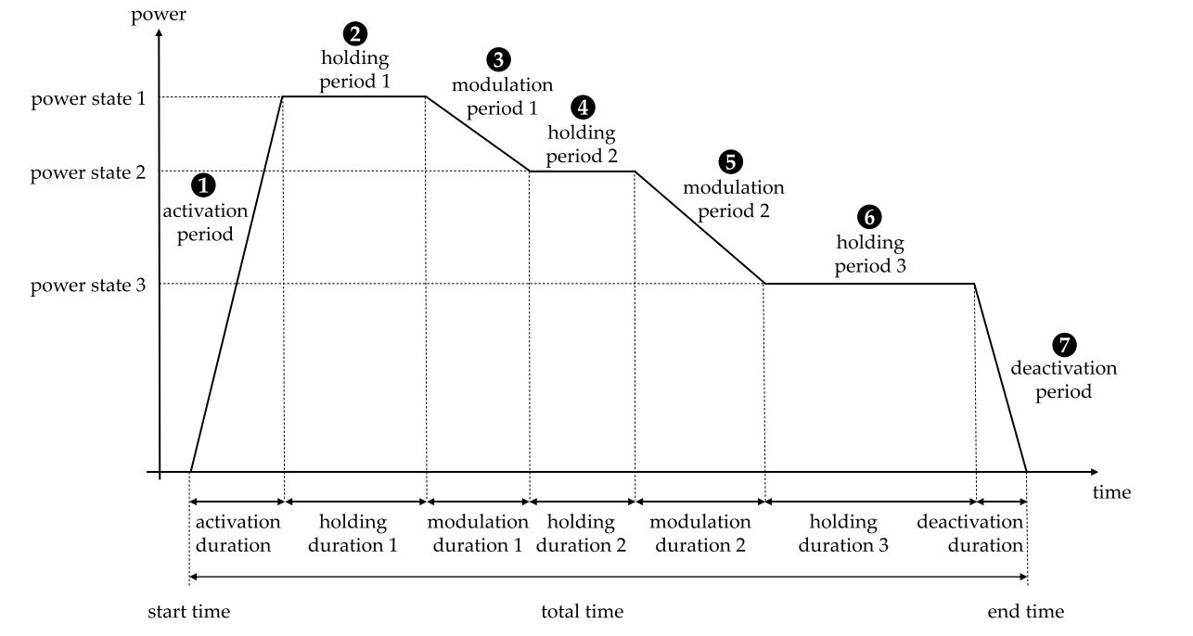
Flexibility
”Flexibility is ability of a component or a collection of components to response challenges caused by power fluctuations in energy systems. ”
”During excess RE, this response can be achieved by flexible P2X, as the amount of consumed/stored energy can be increased to higher load (power) state.”
” Hidden flexibility, the difference between the amount of energy consumed/stored by the simplified (linearized) and the detailed (first order dynamics) model of P2X during flexibility service. ”
RE: Renewable Energy
P2X: Power-to-X
Fig. an exemplary flexible load measure with the corresponding parameters [1]

Slide 5
Research Questions
What options exist for minimizing curtailment of renewables in MES?
Which options are available in industrial area?
How much profit P2X owners can make from shifting demand to low price times?
How much model detail impacts the flexibility analysis?
What should be the detail of a model (heat pump, electrolyser) for desired MES analysis?
What is the optimal deployment of flexibility in order to reduce operational cost for P2X owner?
What should be the control architecture of MES?
How can different energy domains can be combined and optimized for flexibility?
What are the dependencies between flexible load pairs?
MES: Multi Energy System
P2X: Power-to-X

Slide 6
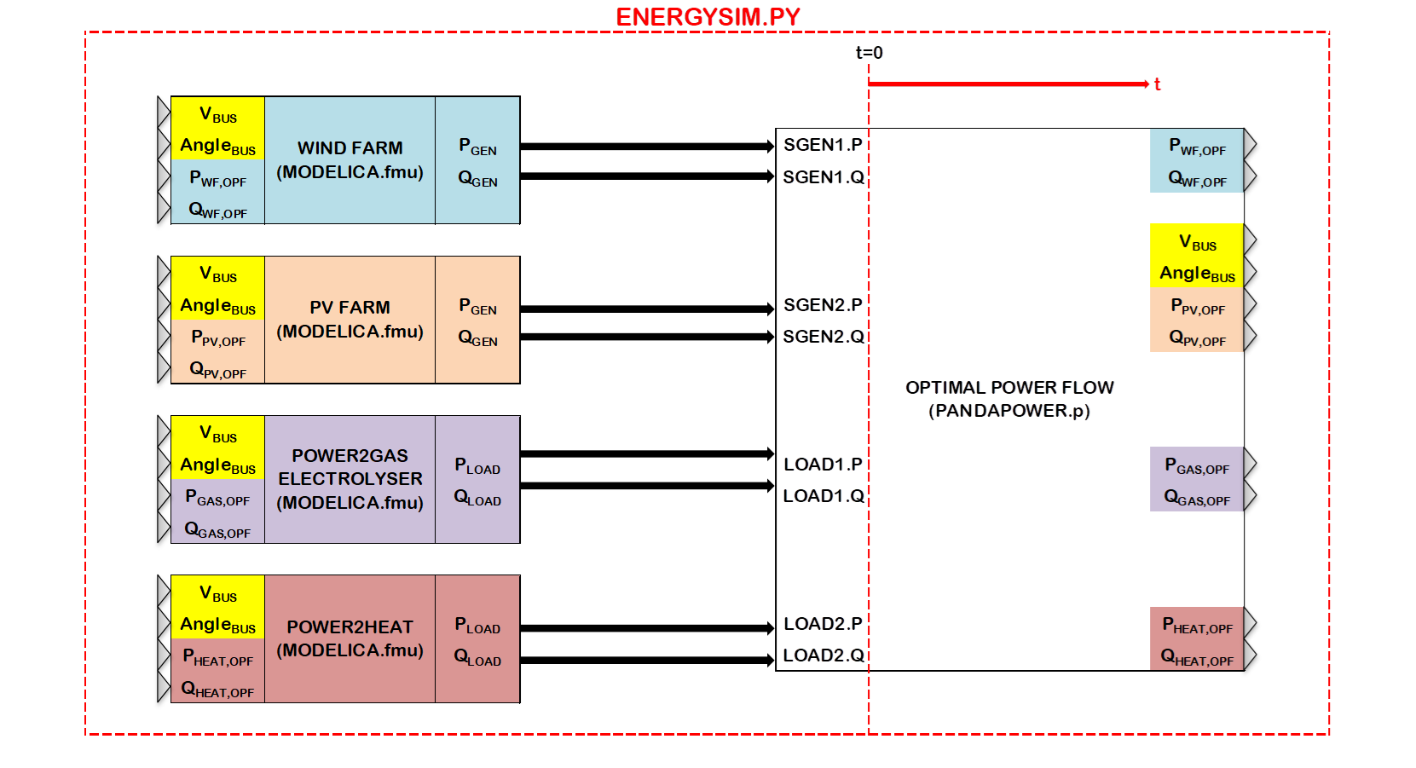
Methodology – Tools
Pandapower
To initialize OM models and run optimal power flow
OpenModelica
For fast simulation of complex dynamics from different energy domains
Energysim (Co-simulation)
To implement hierarchical control, reduce computational burden using only necessary I/O’s and couple different energy domains.
OM:OpenModelica
I/O: Input/Output

Slide 7
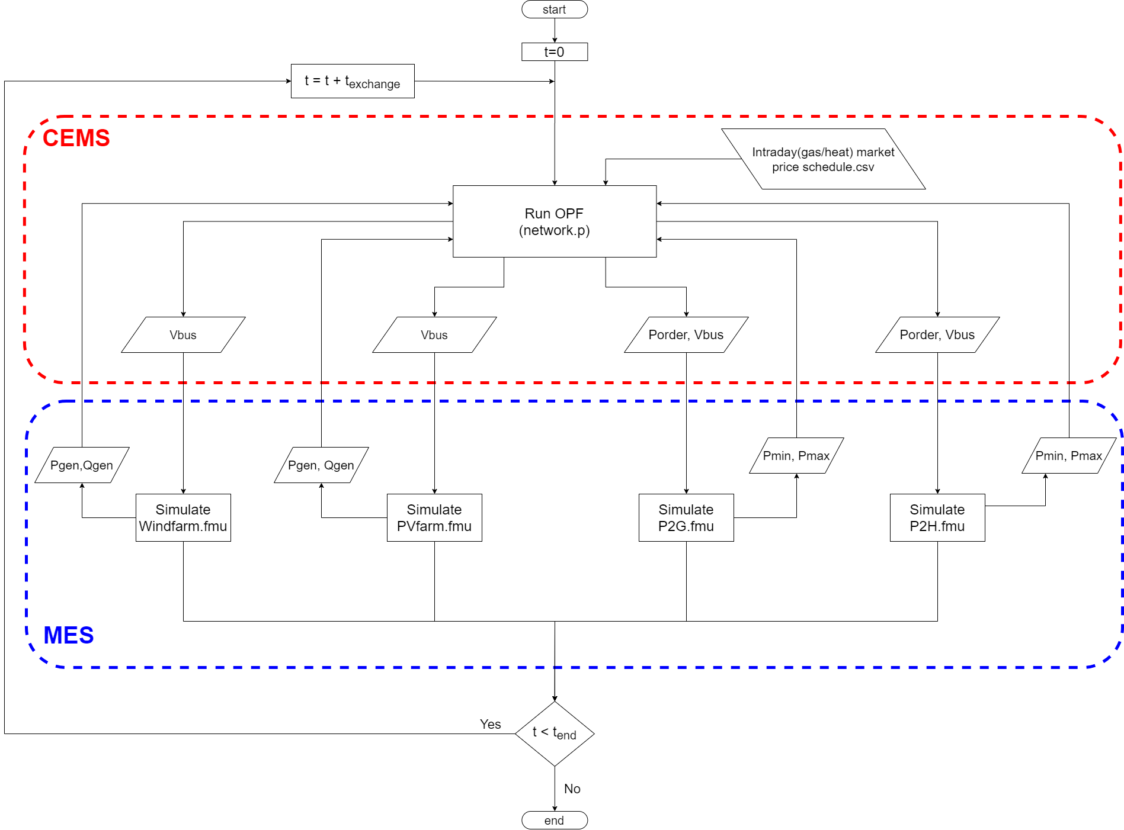
Methodology – Hierarchical Control (DSM)
MES: Multi Energy System
DSM: Demand-side management
CEMS: Community Energy Management System
OPF: Optimal Power Flow

Slide 8
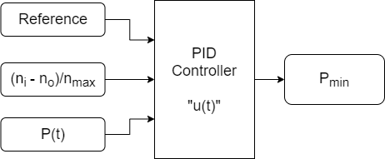

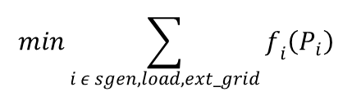
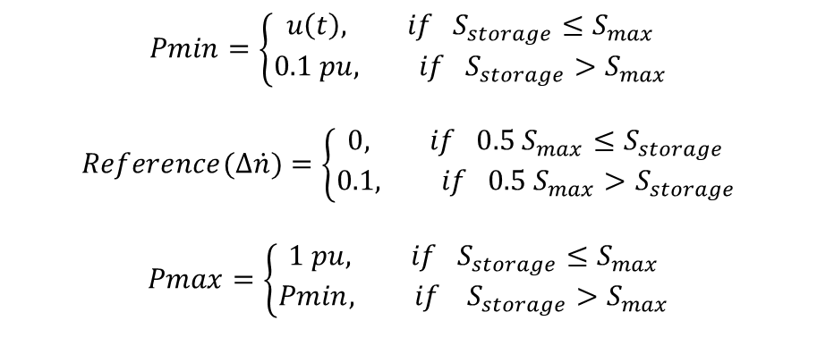

Methodology - Optimum Demand Side Management of Flexibility
$$min\sum_{i ε sgen, load,ext_grid}{f_{i}\left(P_{i}\right)}$$
Objective function:
$$f_{pol}\left(p\right)=c_{n}p^{n}+…+c_{1}p+c_{0}$$
Cost function:
Constraints:
$$Pmin≤Porder≤Pmax, Porder ε P2X.p$$
$$Vmin≤V≤Vmax, V ε bus.p$$
$$Pmin=\left\{\begin{aligned}u\left(t\right), if S_{storage}≤S_{max} \\ 0.1 pu, if S_{storage}>S_{max}\end{aligned}\right.$$
$$Reference(∆\dot{n})=\left\{\begin{aligned}0, if {0.5 S}_{max}≤S_{storage} \\ 0.1, if {0.5 S}_{max}>S_{storage}\end{aligned}\right.$$
$$Pmax=\left\{\begin{aligned}1 pu, if S_{storage}≤S_{max} \\ Pmin, if S_{storage}>S_{max}\end{aligned}\right.$$
n_{i} : charging flow rate
n_{o}: discharging flow rate

Slide 9
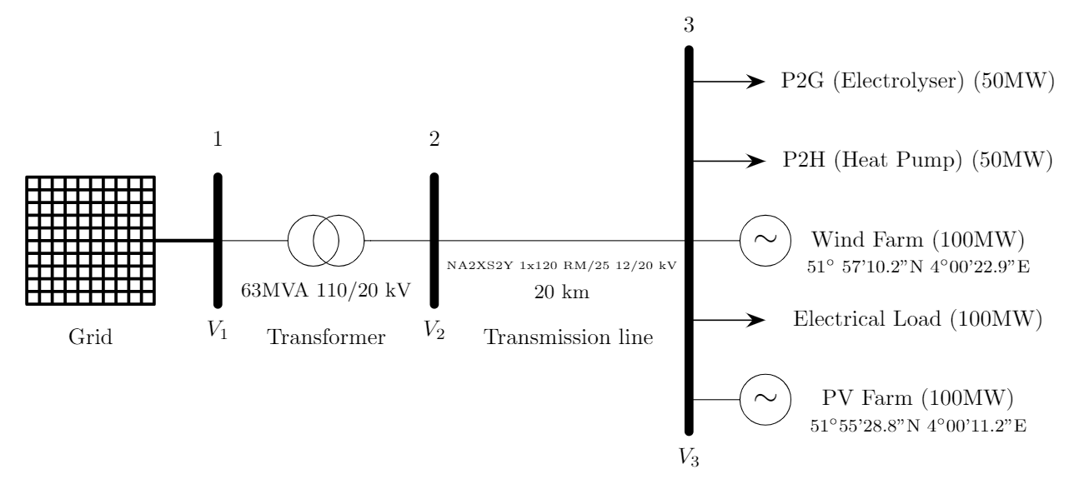
Methodology – Maasvlakte Energy Park
(Bode & Schmitz, 2018) compares different combinations of MES and concluded that, a combination of P2G with electric heat pumps or combined cycle gas turbines has the best cost performance in a MES with renewables.
MES: Multi Energy System
P2G: Power-to-Gas
P2H: Power-to-Heat
Notes:
The figure includes the
processes that allow for the storage and transport of electrical energy (Gray blocks)

Slide 10
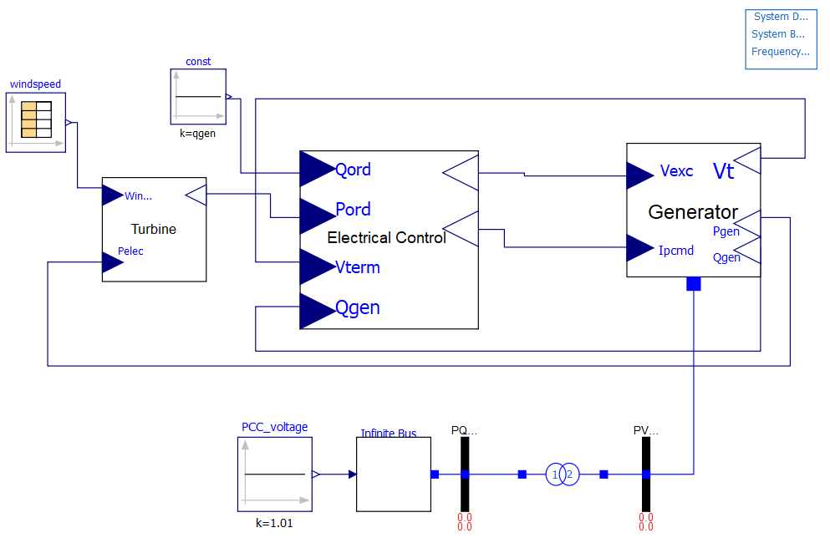
Modelling – Wind Turbine Generator
Turbine, converts mechanical power from wind into AC power order
Control, commands the active and reactive power generated
Generator, provides interface between the controller and network

Slide 11
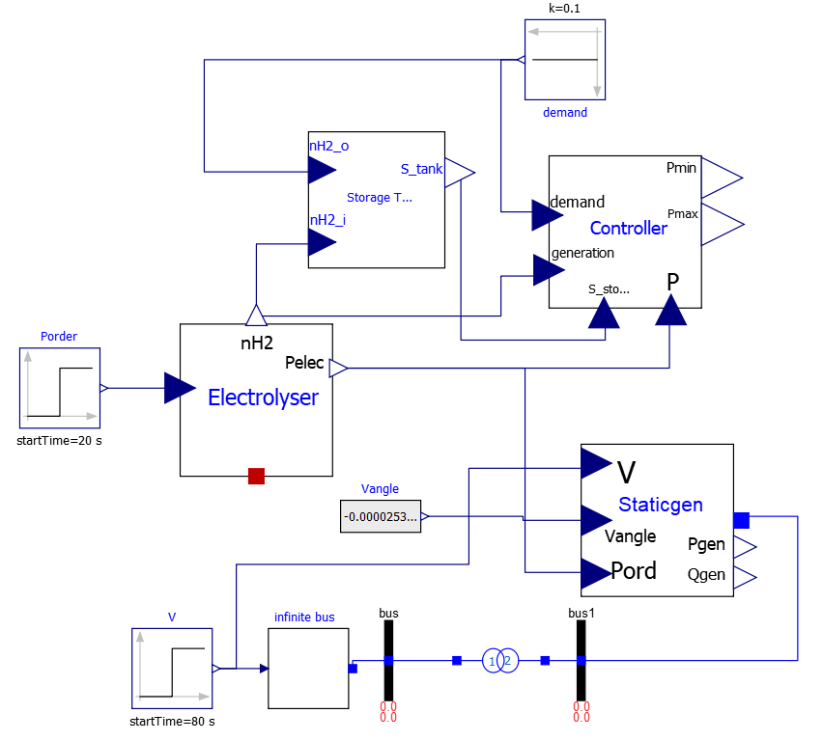
Modelling – Power-to-Gas
Storage, calculates energy stored
Electrolyser, calculates electrical power consumed and H₂ flow rate
StaticGenerator, provides electrical interface and controls Qload
Controller, calculates Pmin, Pmax constraints for PandaPower

Slide 12
Co-Simulation Cases
First case:
To determine the holding duration for providing flexibility, plot the “active power demand/generation at bus3 vs. time” without any flexibility. Plot the same figure in all cases in order to investigate the effect of flexibility on active power balance.
Second case:
To investigate the hidden flexibilities, compare the amount of flexibility provided at nominal active power order for different Electrolyser models, but for same holding time decided in case 1. Do the same for heat pump model.
Third case:
To investigate the effect of hierarchical control on flexibility, add community energy management system to the combined (P2H & P2G) MES and measure the amount of flexibility by P2G & P2H.
MES: Multi Energy System
P2G: Power-to-Gas
P2H: Power-to-Heat

Slide 13
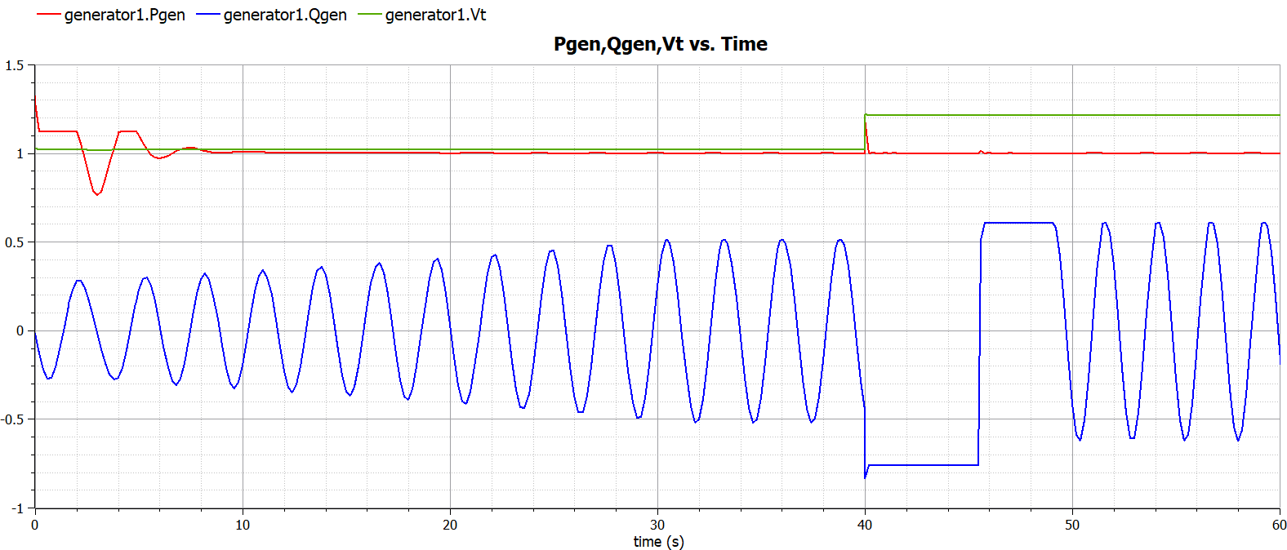
Initial Results - WindTurbineGen

Slide 14
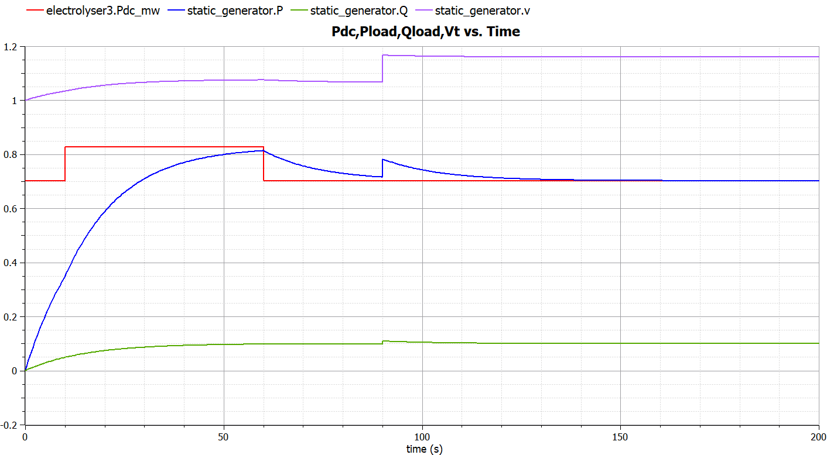
Initial Results – Power-to-Gas

Slide 15
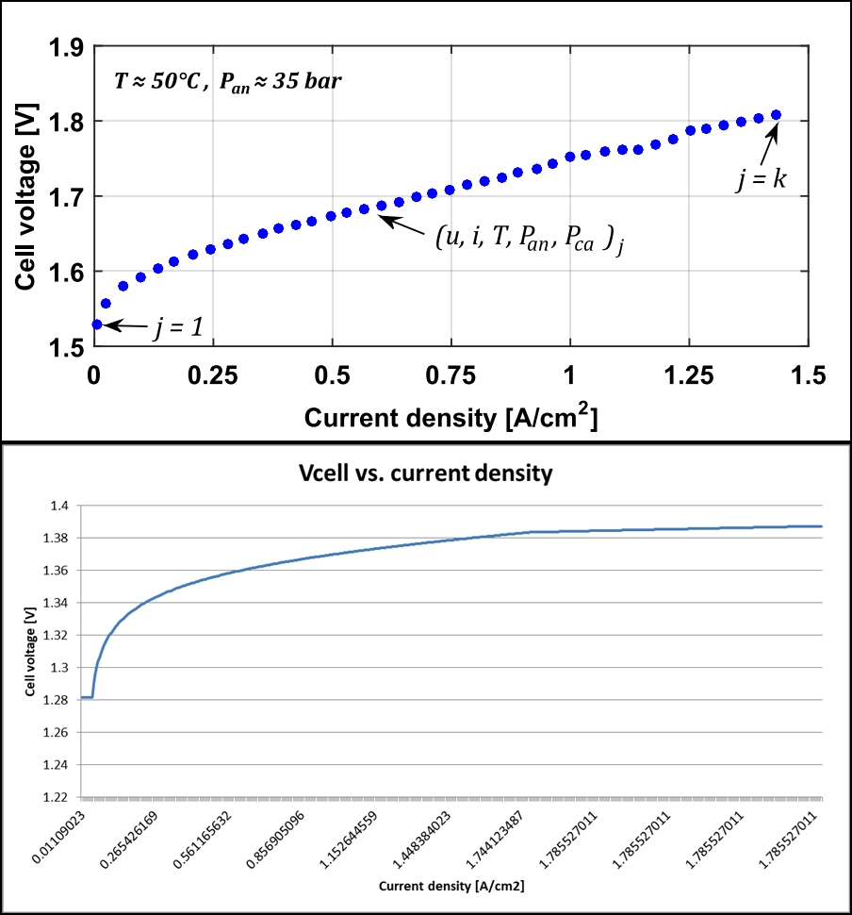
Initial Results - Electrolyser

Slide 16
Future Plans
Finalize PVfarm.fmu and P2H.fmu models
Create input data (windspeed.txt, solar irradiation.txt, demand profiles.csv)
Combine models in Energysim for co-simulation
Add more losses/dynamics and ambient temperature connector “heatport”
Improve resolution of weather data
CEMS: Community Energy Management System

Slide 17
References
[1] P. Schott, J. Sedlmeir, N. Strobel, T. Weber, G. Fridgen, and E. Abele, “A generic data model for describing flexibility in power markets,” Energies, vol. 12, no. 10, pp. 1–29, 2019.
[2] P. D. Lund, J. Lindgren, J. Mikkola, and J. Salpakari, “Review of energy system flexibility measures to enable high levels of variable renewable electricity,” Renew. Sustain. Energy Rev., vol. 45, pp. 785–807, 2015.
[3] Gusain, D, Cvetković, M & Palensky, P 2019, Energy flexibility analysis using FMUWorld. in 2019 IEEE Milan PowerTech., 8810433, IEEE, 2019 IEEE Milan PowerTech, PowerTech 2019, Milan, Italy, 23/06/19. https://doi.org/10.1109/PTC.2019.8810433
[4] P. Dubucq and G. Ackermann, “Frequency control in coupled energy systems with high penetration of renewable energies,” 5th Int. Conf. Clean Electr. Power Renew. Energy Resour. Impact, ICCEP 2015, pp. 326–332, 2015.
[5] C. Bode and G. Schmitz, “Dynamic simulation and comparison of different configurations for a coupled energy system with 100% renewables,” Energy Procedia, vol. 155, pp. 412–430, 2018.
[6] P. Palensky and D. Dietrich, “Demand side management: Demand response, intelligent energy systems, and smart loads,” IEEE Trans. Ind. Informatics, vol. 7, no. 3, pp. 381–388, 2011.

Slide 18
Multi Energy Systems: Investigating Hidden Flexibilities Provided by Power-to-X Considering Grid Support Strategies
MSc: Bekir Caner Yagci (4857089)
PhD: Digvijay Gusain
Supervisor: Asst. Prof. Milos Cvetkovic
E-mail: B.C.Yagci@student.tudelft.nl
Version Control: https://github.com/caneryagci/Multi-Energy-Systems-Thesis-Project.git

